Slide 1
HRIT/EMWIN:
The Evolution of LRIT and EMWIN
1st DCSRB and 7th GOES User’s Conference
Oct 19-21, 2011

Slide 2
Agenda
What is LRIT
What is EMWIN
What is HRIT/EMWIN
HRIT/EMWIN Concept of Operations
Potential Imagery Scenarios

Slide 3
What is LRIT?
Brief overview of
Low Rate Information Transmission

Slide 4
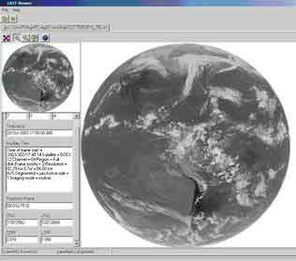
Low Rate Information Transmission (LRIT)
LRIT is a collection of reduced resolution NOAA data and products, packaged into a single stream, and rebroadcast over NOAA geostationary satellites
Users can obtain this information with relatively low cost ground systems
No subscription fee necessary
Available from Western Africa to the Pacific islands

Slide 5
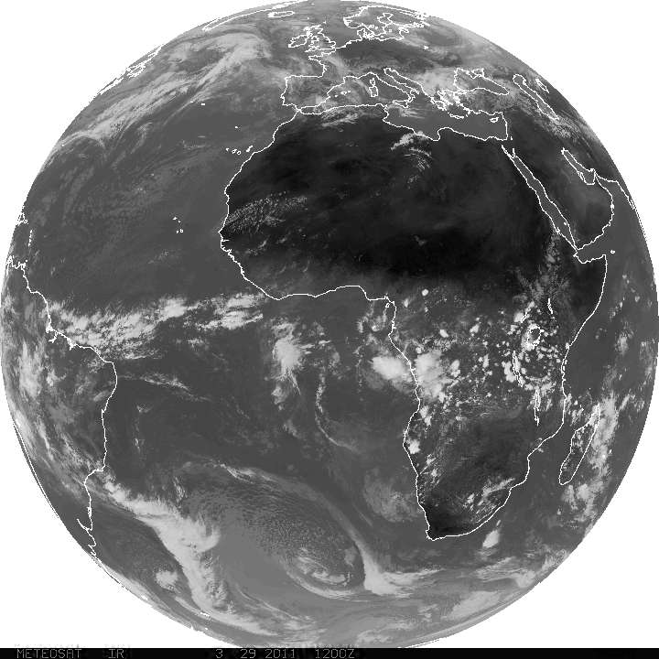
Low Rate Information Transmission
L-Band LRIT Specifications
GOES-11/12/13/14
  Frequency: 1691.0 MHz
  Data Rate: 128 kbps
  Modulation: BPSK
  Polarization: Linear
  LRIT on GOES-11 off during eclipse
    Eclipse outages in spring and fall
  No LRIT broadcast on GOES-12

Slide 6
Low Rate Information Transmission
Products
  LRIT-East: All GOES-East Visible/Infrared/Water Vapor imagery plus GOES-West IR
  LRIT-West: All GOES-West Visible/Infrared/Water Vapor imagery plus GOES-East IR
  Graphic images of MSG and MTSAT
  Tropical storm information
  Copy of EMWIN broadcast
  GOES Data Collection System rebroadcast
  Administrative messages

Slide 7
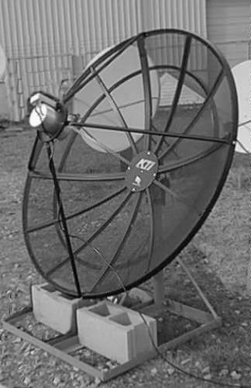
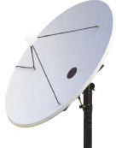
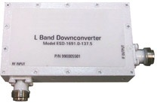
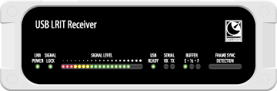
Current LRIT User Station
Notes:
LRIT antenna source: http://wattsupwiththat.com/2010/06/10/noaa-goes-satellite-communications-at-risk-due-to-proposed-fcc-spectrum-auction/
: http://www.dartcom.co.uk/products/lrit_hrit/hardware/index.php
EMWIN Source: LRIT Receiver source

Slide 8
What is EMWIN?
Brief overview of the
Emergency Managers Weather Information Network

Slide 9
Emergency Managers Weather Information Network
The Emergency Managers Weather Information Network (EMWIN) is a low cost, priority-driven weather data broadcast service that provides one of the most robust NWS systems for public weather dissemination
EMWIN provides rapid satellite, internet and VHF radio broadcasts of:
  Alerts/Watches/Warnings < 1 minute
  Forecasts
  Graphics, Imagery

Slide 10
EMWIN Assets
Large footprint
  EMWIN broadcast covers over 2/3rd’s of the earth’s surface
  Used internationally in the Pacific rim, Caribbean and parts of South America
Reliable
  Transponders on GOES East and West for redundancy
  Requires little infrastructure in a disaster, not dependent on internet or utility lines
  24/7 since 1996 with almost zero down time
  L-band signal adds to reliability
Inexpensive equipment and software
  No subscription satellite service.
  Free software defined radio receiver application
  Small form factor equipment, can even be used mobile

Slide 11
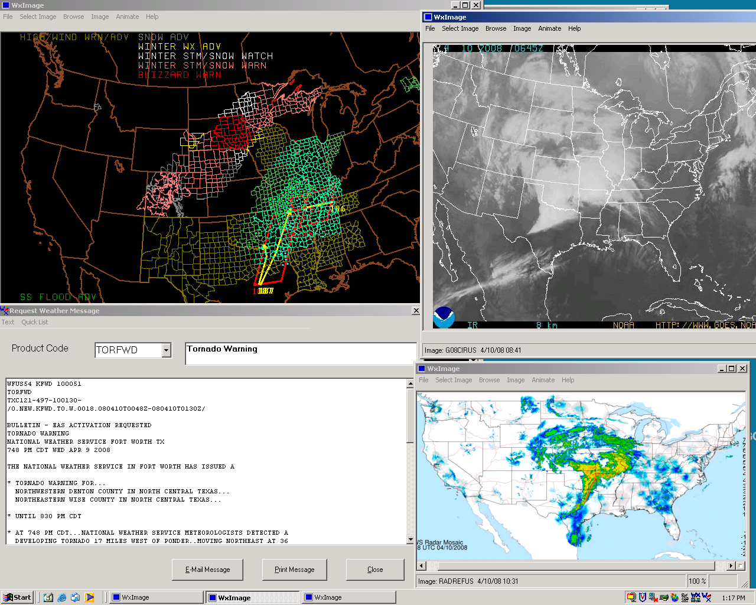
EMWIN User Receive System
Screen Shots

Slide 12
EMWIN GOES-N Satellites
GOES N thru P changes
  Data rate doubles from legacy EMWIN
  Forward error correction
  Offset QPSK modulation
  Allows enhancement of the data stream
  Coding gains used to retain current user dish size
  Dedicated transponder
  No eclipse outage
GOES East was replaced April 2010
GOES West will be replaced December 14, 2011
  Users that have not yet transitioned should check EMWIN site for details

Slide 13
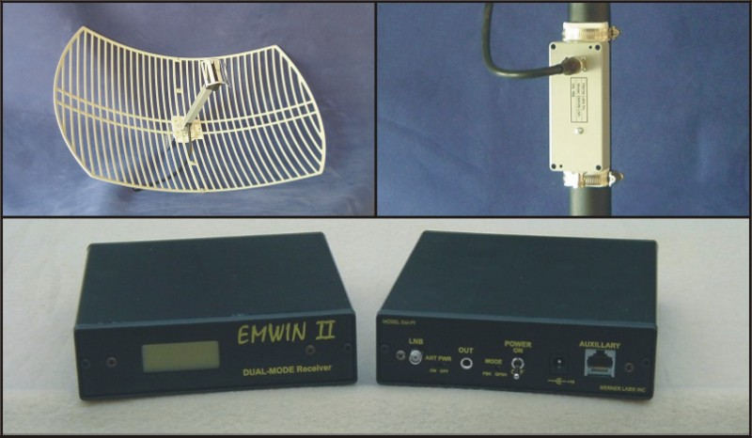
Current EMWIN User Station
Notes:
http://www.wernerlabsinc.com/system.htm
From Werner Labs website: Entire system $1999
Antenna only is $499

Slide 14
LRIT and EMWIN
System Overview

Slide 15
LRIT & EMWIN High Level Overview (Current)

Slide 16
What is HRIT/EMWIN
Brief overview of
High Rate Information Transmission / Emergency Managers Weather Information Network

Slide 17
LRIT and EMWIN in the GOES-R Era
LRIT
EMWIN
a
HRIT/EMWIN
400Kbps
    Frequency: 1694.1 MHz
    Modulation: BPSK
    Polarization: Linear
    Forward error correction
Notes:
Higher data rate causes name change to stay consistent with CGMS standards.

Slide 18

HRIT/EMWIN Broadcast
GOES Product improvements
    GOES-R Advanced Baseline Imager products
    More frequent full-disk images
    Higher resolution and/or more image channels
      Potential for some GOES-R level 2+ products
EMWIN Enhancements
    More International Data
    Additional Weather Graphics and Graphical Forecasts
Primary re-broadcast for GOES DCS data
Additional imagery from MTSAT and/or Meteosat

Slide 19
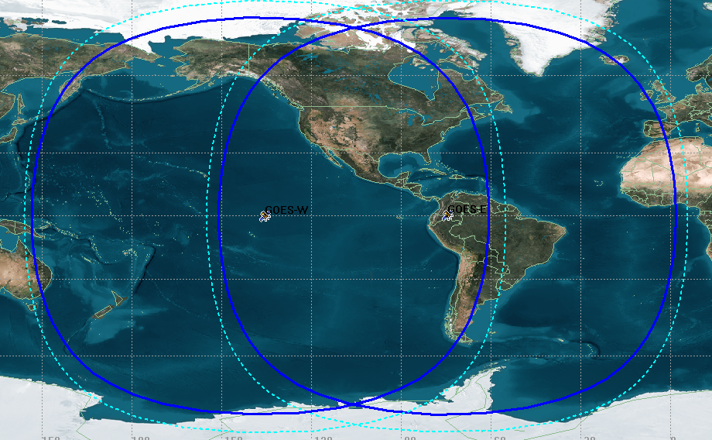
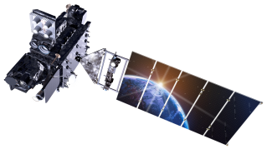
HRIT/EMWIN Broadcast Footprint
Dashed line is the current EMWIN footprint
Solid line is the expected HRIT/EMWIN footprint
Notes:
Current LRIT footprint is close to the expected HRIT/EMWIN footprint. The current LRIT has the same minimum elevation angle however, the GOES-W satellite is expected to be 2 degrees further west in the GOES-R series. For the current LRIT signal the GOES-E area is the same, the GOES-W circle will be moved 2 degrees to the east.

Slide 20
HRIT/EMWIN Operations Concept

Slide 21
Current State
LRIT Ground System Overview

Slide 22
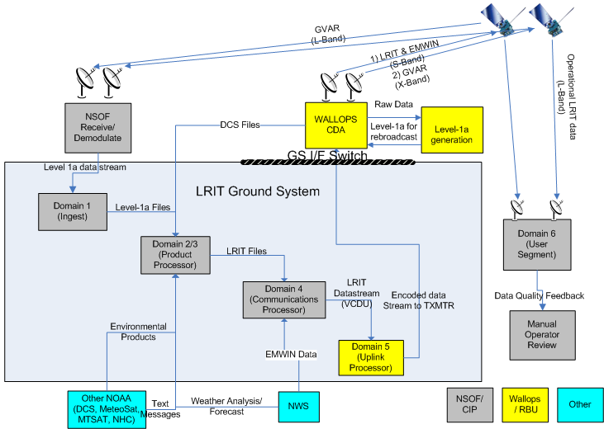
LRIT Notional Architecture

Slide 23
Current Domain Descriptions
Domain | Main Function | Incoming Data | Outgoing Data | Location
1 Ingest | Convert Level 1a GOES data (GVAR) into area files | Level 1a GOES data | Level 1a GOES partitioned into areas | NSOF/CIP
2/3 Products Processor | Convert the Level 1a GOES data into Level 1b Generate LRIT files containing multiple types of data | GOES imagery from Domain 1 DCS files Weather forecasts Text Alerts Other NOAA satellite products | LRIT files | NSOF/CIP
4 Communications Processor | Accept EMWIN data from NWS and convert to LRIT files Convert LRIT files into a VCDU packet stream | LRIT files from Domain 3 EMWIN bit-stream | VCDU bit stream | NSOF/CIP
5 Uplink Processor | Performs signal encoding, modulation and frequency conversion Performs transmission encoding including adding checksums, sequence counters, and Reed-Solomon | LRIT data in VCDU packet format | Serial bit stream modulated in accordance with GOES antenna requirements | WCDAS

Slide 24
System Update Drivers
What are the reasons for making system updates?

Slide 25
System Update Drivers
Joint Mission - LRIT only acts as a rebroadcast of GOES DCS and EMWIN data
Continuity – Current system requires downtime to perform:
  System updates such as O/S patches
  Product changes such as algorithm or parameter updates
GOES Data – GOES-R features the Advanced Baseline Imager (ABI)
Sustainability – Interface to NWS for EMWIN data utilizes an obsolete infrastructure
Monitoring – Currently signal monitoring is a manual process
Notes:
Signal Encoding – Line coding, Pseudo-randomization polynomial and uplink filter all changed in Space Segment Specification
Data Rate change – Combined data rate is 400kbps; now called High Rate Information Transmission (HRIT)
LRIT – 128 kbps
EMWIN – 9.6 kbps (GOES I-M) and 19.2 (GOES N/O/P)

Slide 26
HRIT/EMWIN Future State
What will the new HRIT/EMWIN system look like?

Slide 27
HRIT/EMWIN System Update Objectives
Continuing to provide high-reliability in data transmission
Minimizing the impact of the HRIT/EMWIN changes to users
Improving the maintainability of the current system
Improving the product content of the current LRIT and EMWIN systems

Slide 28
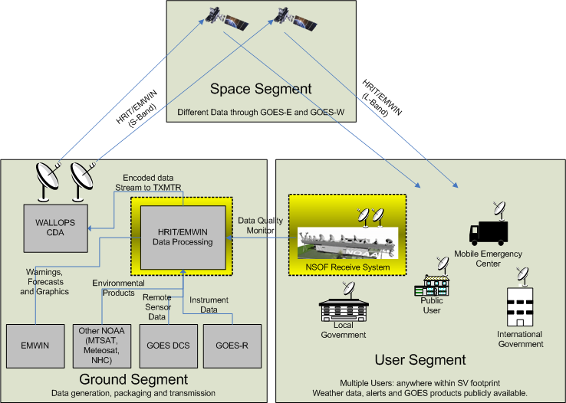
HRIT/EMWIN High Level Overview (Proposed)
Notes:
Diagram shows the Operational View (DoDAF OV-1) of the entire HRIT/EMWIN program including all major interfaces. As with any satellite system there are three main components: a ground segment, a space segment and a user segment. For the purposes of this presentation and the development work under ESPDS WA #6, the HRIT/EMWIN system spans the ground and user segment and is indicated in the dashed boxes.

Slide 29
Major Capabilities

Slide 30
Virtual Channelization
Continue to leverage CCSDS data transmission protocols
  Key feature is division of physical medium into virtual channels
Each piece of data can be assigned a unique virtual channel
  Assignment made by priority, data source, data type etc.
  For example: NWS Weather forecasts may be assigned one channel while NWS Weather Alerts are on another
Virtual channels can be treated differently at receive station
  Individual channels can be selected for processing
    For example, a user that is only interested in GOES DCS data can “ignore” all channels except the DCS channels
  Data from different channels can be routed to different end points
Notes:
CCSDS Consultative Committee on Space Data Systems
6 bits for VCID (could also leverage SCID if necessary) to allow for 63 VCs (all 1s is reserved for fill data)

Slide 31
Virtual Channels – Example only
Product Name | Source | Virtual Channel
GOES-R Visible | GOES-R | 14
GOES-R Infrared | GOES-R | 15
GOES-R Water Vapor | GOES-R | 16
Tropical Storm Products | NOAA/NWS Hurricane Center | 21
EMWIN Weather Alerts | National Weather Service | 22
EMWIN Weather Forecast | National Weather Service | 23
DCS (Normal Data) | NOAA/NESDIS/OSPO | 24
DCS Tsunami Warning | NOAA/NESDIS/OSPO | 25
Meteosat Second Generation (MSG) | NOAA/NESDIS/OSPO | 26
MTSAT | NOAA/NESDIS/OSPO | 27
Administrative Text Message | HRIT/EMWIN System Administrators | 60

Slide 32
Dynamic Bandwidth Allocation
HRIT/EMWIN is capable of 400kbps data transfer
  Need to allocate a percentage of total bandwidth to each data type
  Allocation may need to change over time
    User needs change
    New data types available
    Current events
System will feature configurable bandwidth groups
  Each data item will be assigned a bandwidth group
  Assignment may be based on priority, data source, data type etc.
Each bandwidth group will be assigned a minimum guaranteed bandwidth
  Unutilized bandwidth can be re-allocated

Slide 33
Configurable Broadcast
Broadcast tailored to user needs
  Unused products can be removed
  New products can be added
  Timing/frequency modified
Some data simply added to broadcast queue upon receipt by HRIT/EMWIN
  GOES DCS data
  NWS Weather Alerts
  Administrative text messages
Ability to schedule data retrieval
  For example, retrieve Meteosat and MTSAT products and broadcast
Recurring imagery
  GOES products can be transmitted on a regular schedule

Slide 34
Data Quality and System Monitoring
Automate signal monitoring
  Locally acquire and process broadcast signal
  Compare received data with transmitted data
Automated contingency response
  Assist operators in quick system recovery
Automatically rebroadcast high priority data

Slide 35
Unchanged Features
GOES-E and GOES-W broadcast tailoring
  Majority of broadcast identical
  GOES-E broadcast will feature satellite imagery from GOES-E
  GOES-W broadcast will feature satellite imagery from GOES-W
Data file formatting
  Continue to leverage CGMS LRIT/HRIT file specification
  HRIT file format is identical to LRIT file format
Prioritization
  System will support internal prioritization to ensure urgent data is broadcast as quickly as possible
Notes:
CGMS Coordination Group for Meteorological Satellites

Slide 36
HRIT/EMWIN Schedule
When is this all going to happen?

Slide 37
HRIT/EMWIN Key Dates
GOES-13
GOES-15
GOES-S
GOES-11
GOES-14
GOES-R
Operational
GOES-R GS I/F Ready
Start
Completion
Operational Need
Post-Launch Testing
End To End
Test
Operations
Testing
GOES-R Launch
GOES-S Launch
GOES-T Launch
LRIT Capable GOES
HRIT/EMWIN overlap with LRIT & EMWIN
HRIT/EMWIN Exclusive
HRIT Capable GOES
Notes:
Operational GOES satellite dates from GOES Flyout schedule dated May 2011 and authorized/signed by Mary Kicza
GOES Launch dates approximate and extracted from GOES Flyout schedule
GOES-R GS dates from IMS status supplied by Bob Latin for March 16, 2011 and End to End test date supplied by Craig Keeler.
ETE 1 Aug 2013
Operations Test 4/27/2015
Post Launch Testing 3/31/2016

Slide 38
GOES-R Imagery
GOES-R imagery broadcast defined by user needs

Slide 39
Current Broadcast
Every GOES image
  Full disk every 3 hours
  Northern Hemisphere every 30 minutes
  Southern Hemisphere every 30 minutes
  Continental United States (CONUS) every 30 minutes
Three channels:
4km resolution
Channel Number | Description | Wavelength Range (µm)
1 | Visible | 0.55-0.75
3 | Moisture | 6.50-7.00
5 | Infrared-2 | 11.50-12.50

Slide 40
Image Scenario Considerations
GOES-R ABI improvements
  Much higher scan rate
    Full disk every 15 minutes
    CONUS every 5 minutes
  Increased resolution
    As fine as ½-1 km for some channels
    2km for most channels
  More available channels
    Total of 16 available channels across a wide spectrum

Slide 41
GOES-R ABI Channels (1 of 2)
Channel Number | Description | Wavelength Range (µm)
1 | Daytime aerosol over land | 0.45-0.49
2 | Daytime clouds, fog, insolation, winds | 0.59-0.69
3 | Daytime vegetation/burn scar and aerosol over water, winds | 0.846-0.885
4 | Daytime cirrus cloud | 1.371-1.386
5 | Daytime cloud-top phase and particle size, snow | 1.58-1.64
6 | Daytime land/cloud properties, particle size, vegetation, snow | 2.225-2.275
7 | Surface and cloud, fog at night, fire, winds | 3.80-4.00
8 | High-level atmospheric water vapor, winds, rainfall | 5.77-6.6

Slide 42
GOES-R ABI Channels (2 of 2)
Channel Number | Description | Wavelength Range (µm)
9 | Mid-level atmospheric water vapor, winds, rainfall | 6.75-7.15
10 | Lower-level water vapor, winds and SO₂ | 7.24-7.44
11 | Total water for stability, cloud phase, dust, SO₂, rainfall | 8.3-8.7
12 | Total ozone, turbulence, and winds | 9.42-9.8
13 | Surface and cloud | 10.1-10.6
14 | Imagery, SSR, clouds, rainfall | 10.8-11.6
15 | Total water, ash and SST | 11.8-12.8
16 | Air temperature, cloud heights and amounts | 13.0-13.6

Slide 43
Potential Imagery Scenarios
Seeking optimal levels of delivery frequency, resolution and number of channels
  Depending on user needs
Definitions
  Image set – Multiple images from the same scan each from a different channel
  TBEI – Time between each image
  TBFS – Time between full image set
Each scenario shows the relative weight given to delivery frequency, number of channels and resolution
  Resolution between 2km and 4km
  TBFS between 15-35 minutes
  TBEI between 2.5 and 11 minutes
  Between 3 and 15 channels

Slide 44
Scenario 1 - Current Method
Notes:
This scenario replicates the current method of sending a copy of each image captured at 4km resolution. It includes an extra channel over the current 3. Result is a full-disk image every 15 minutes and a CONUS image every 5 minutes.

Slide 45
Scenario 2 – Balanced
Notes:
Scenario includes a set of full-disk images every 15 minutes replicating the current 3 channels, but increasing the resolution from 4KM to 3KM. The images for each channel can be sent serially such that an image for a single channel will be available every 5 minutes with the full set completed every 15 minutes.

Slide 46
Scenario 3 – Balanced with Mixed Resolution
Notes:
This scenario features a set of full-Disk images replicating the current 3 channels, but with mixed resolution; one channel at 2km with the other two at 3km. The full set of all 3 channels transmitted every 20 minutes; if transmitted serially, the 3km channels will be available in 5 minutes but the 2km channel will take about 10 minutes transmit.

Slide 47
Scenario 4 – High Channels
Notes:
Scenario includes a set of full-Disk images every 20 minutes at the current resolution (4km) but increases the available channels to 6. Time between each image channel will be about 2.5 minutes.

Slide 48
Scenario 5 – Increase Resolution, Extra Channel
Notes:
Set of full-Disk images every 20 minutes at 3km resolution, an increase over the current 4km. Even with the increase in resolution, the bandwidth still supports an extra channel for a total of 4. The time between each image channel will be about 5 minutes.

Slide 49
Scenario 6 – Very High Channels
Notes:
This scenario features 11 different channels (16 ABI channels from which to choose) of full-disk images every 30 minutes. The resolution will match the current at 4km. Although it will take 30 minutes for each set of images, the images can be staggered such that a new channel will be available every 2.5 minutes.

Slide 50
Scenario 7 – High Resolution and Channels
Notes:
This scenario includes a set of full-disk images every 30 minutes at an increased resolution (3km) and 3 additional channels for a total of 6. At least one FD channel image can be available every 5 minutes.

Slide 51
Scenario 8 – Extreme Resolution
Notes:
Scenario features a set of full disk images every 35 minutes, replicating the current 3 channels; the images will be double the current resolution of 4km to 2km. Although it will take 35 minutes for the full set to be broadcast, each channel will be available about every 11 minutes.

Slide 52
Scenario 9 – Extreme Channels
Notes:
Set of full-disk images every 40 minutes at the current resolution (4km) but including 15 of the 16 ABI channels. Images can be staggered such that at least one FD channel can be available every 2.5 minutes.

Slide 53
Feedback Requested
Please provide feedback on the potential imagery scenarios to OSD.HRIT@noaa.gov

Slide 54
Contact Information
Paul Seymour
  Paul.Seymour@NOAA.Gov
  301-817-4521
  www.noaasis.noaa.gov
Rob Wagner
  Robert.Wagner@NOAA.Gov
  301-713-0870 x 154
  http://www.weather.gov/emwin
Santos Rodriguez
  Santos.Rodriguez@NOAA.Gov
  301-713-0077
  http://www.weather.gov/emwin
HRIT/EMWIN Info: http://www.goes-r.gov/users/hrit.html

Slide 55
HRIT/EMWIN Prototype Receiver Station Powered by a 6 Volt Battery
Survives the Great Storm of the
2011 Direct Readout Conference

Slide 56
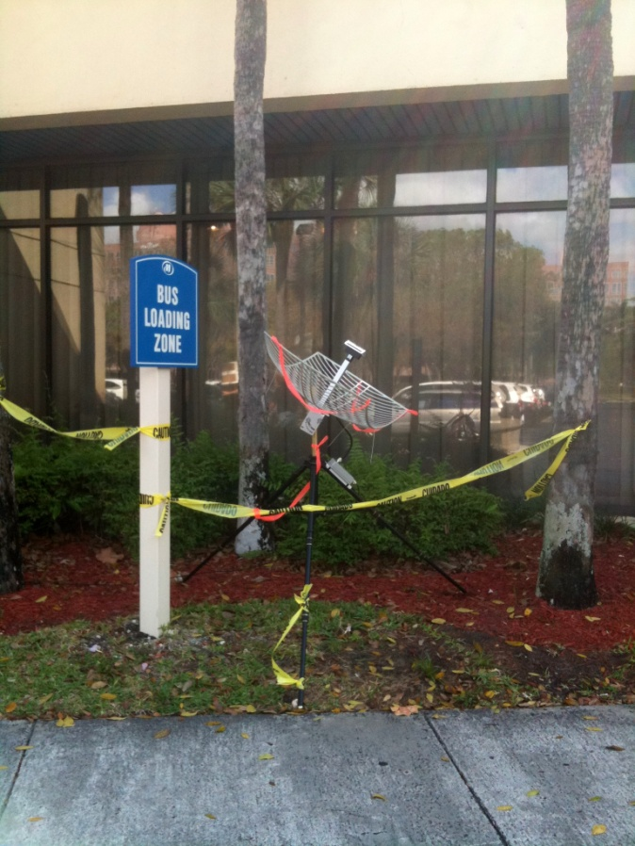
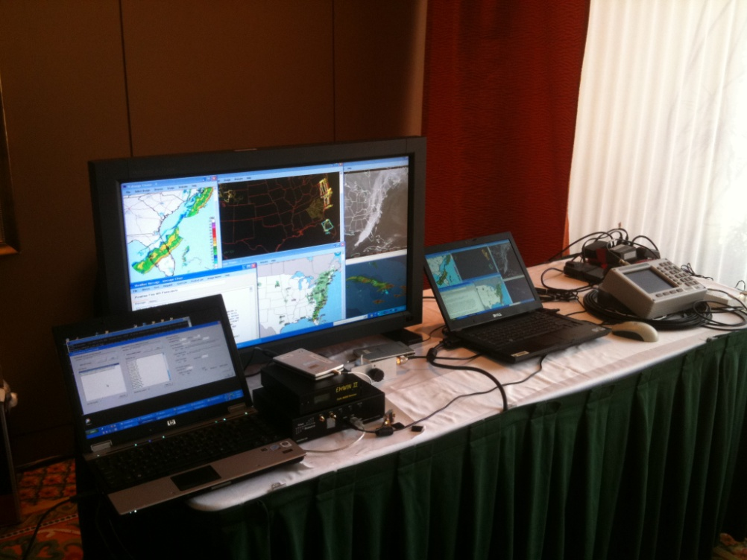

Slide 57
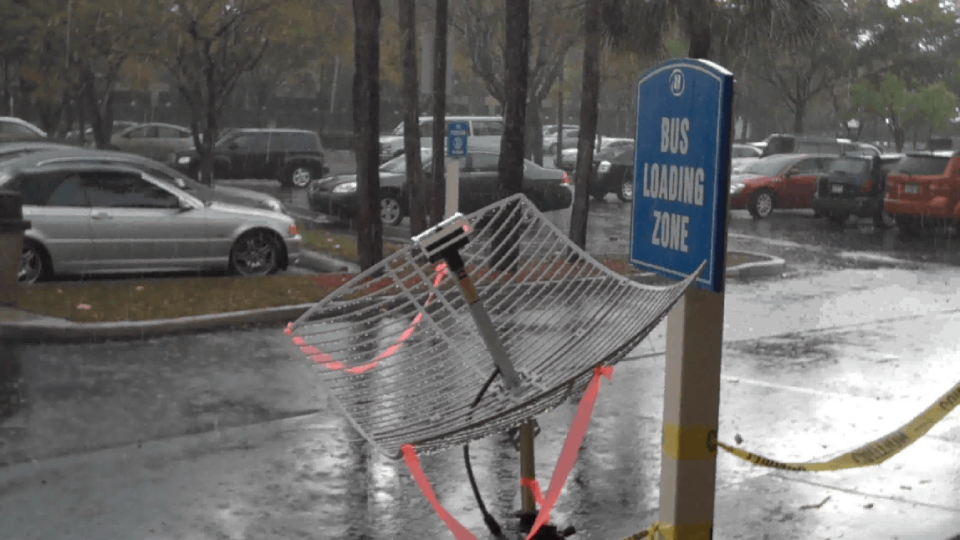

Slide 58
