Slide 1
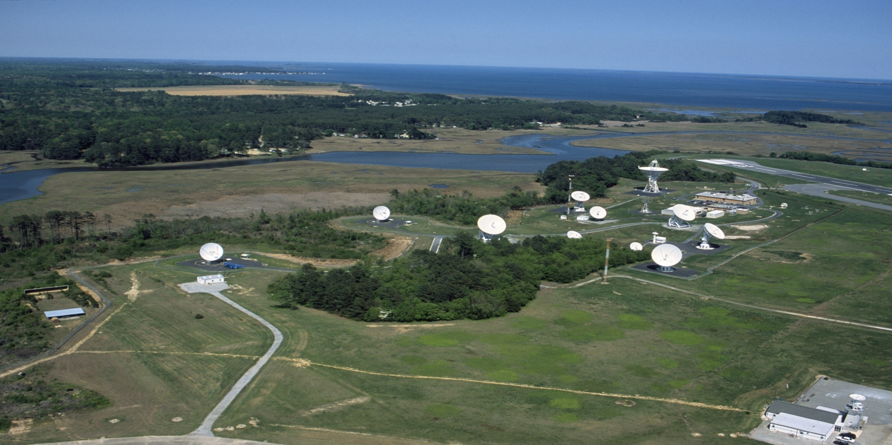
NOAA COMMAND AND DATA ACQUISITION STATION

Slide 2
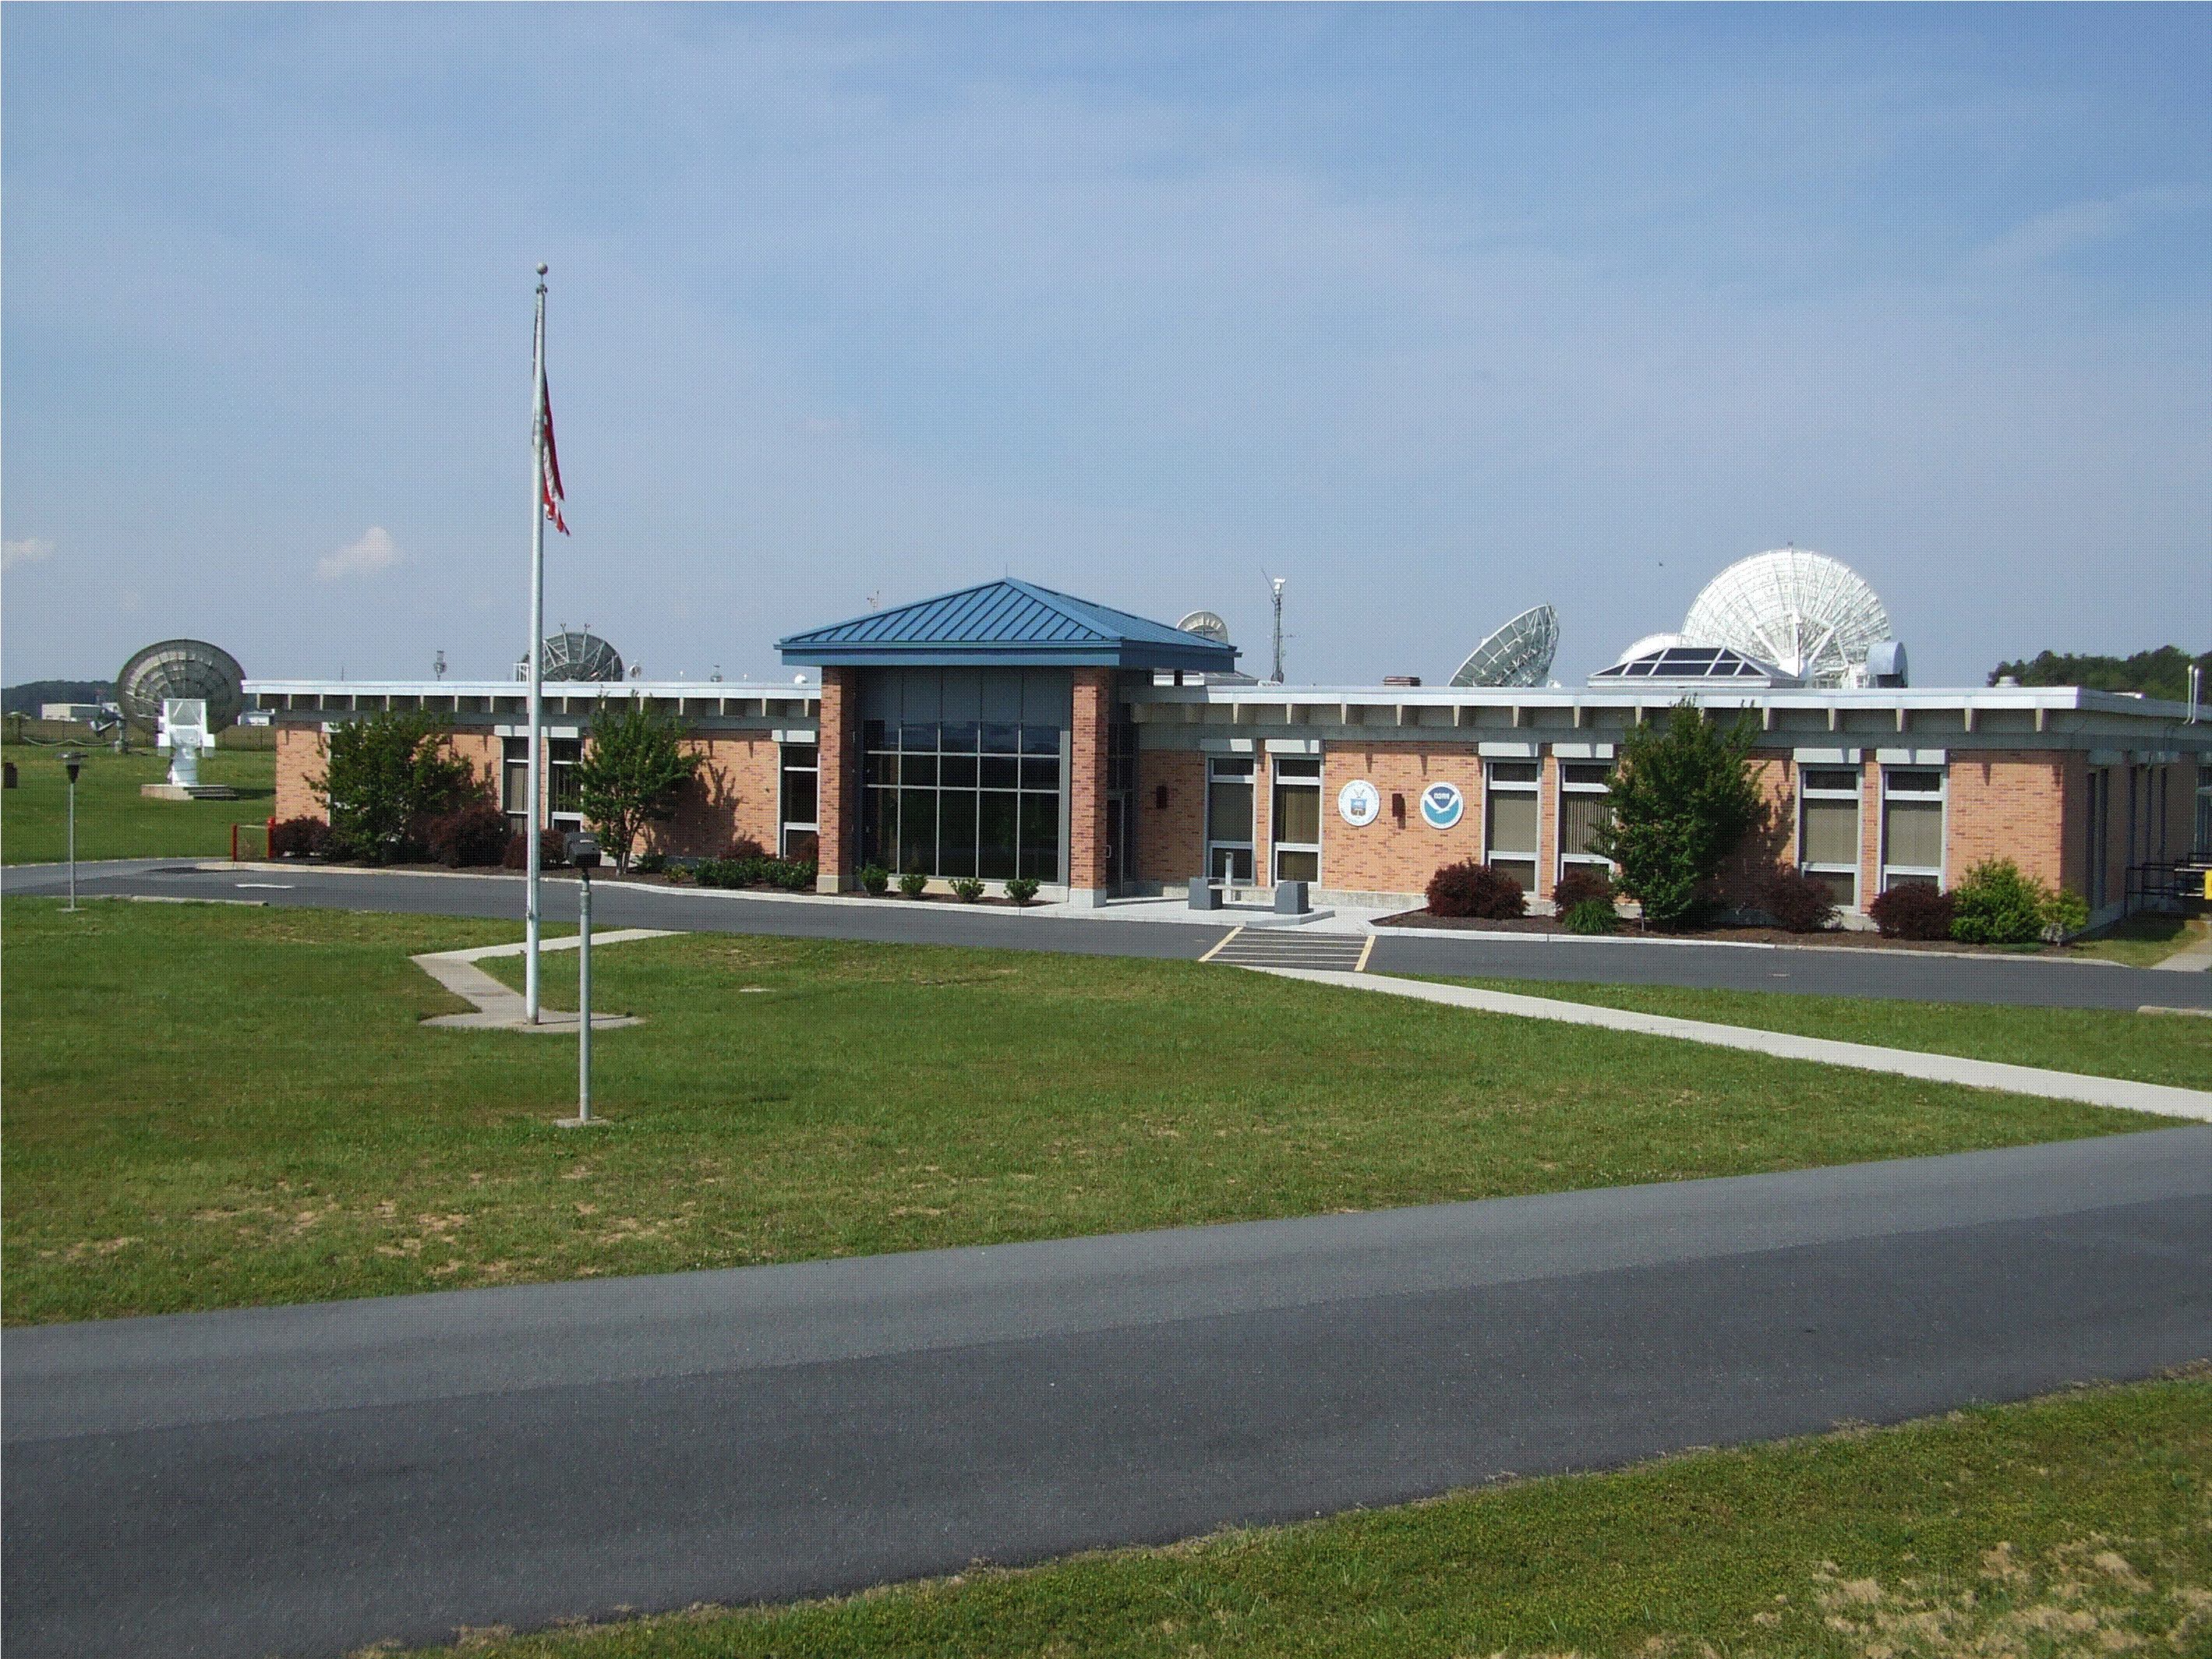

Slide 3
WCDAS Numbers
DCS Help Desk at 757-824-7450 or 7451
Contact Phil Whaley at (757) 824-7331 or Al
McMath at (757) 824-7316
Travis Thornton 757 824-7450

Slide 4
Wallops LRGS Configuration
No real changes to the LRGS
We continue to use version 7.0 as the standard
The cdadata server is considered the primary LRGS, ingesting data from the DCS demods & the cdabackup server.
The cdabackup server is considered the secondary LRGS, ingesting data from the DCS demods & the EDDN server.
The drot should be considered a troubleshooting tool to verify the DOMSAT downlink.
Accounts are built through NOAA and shared with USGS
Wallops LRGS interface with those at NSOF and EDDN to maintain a complete record.

Slide 5
Wallops LRGS Configuration
Analysis by Microcom showed that EDDN and NSOF were receiving 99.5% of the data that is received at Wallops.
No real changes to the LRGS configuration since the last meeting
Sites and IPs:
  http://cdadata.wcda.noaa.gov (205.156.2.174)
  http://drot.wcda.noaa.gov (205.156.2.186)
  http://cdabackup.wcda.noaa.gov (205.156.2.189)

Slide 6
LRIT Status
Files built and transmitted every 30 seconds
Wallops is working with OSDPD to use the backup at Wallops during periods of outages.
The OSDPD failover would be manual – not automatic
The DCS component of LRIT is transferred from Wallops to Suitland (via Internet) and then back to Wallops (via T-1).
1 meter antenna receives full LRIT stream
There are no re-occurring costs associated with LRIT reception.
Available throughout the hemisphere at no charge.

Slide 10
Spacecraft Constellation
GOES-10 de-commissioned in Dec 2009
GOES-13 is prime East S/C @ 75 deg West
GOES-11 is prime West S/C @ 135 deg West
  We did not have to use GOES-13 for DCS/LRIT/EMWIN during recent eclipse events.
  GOES-11 has only one functioning command receiver
  Currently scheduled for decommissioning - Dec 2011
  Replacement s/c is TBD (GOES-14 or 15???)
GOES-12 supporting the South Americans @ 60 deg West
GOES-12 is scheduled for de-commissioning in Dec 2013
No decision on supporting South America after Dec 2013

Slide 11
Spacecraft Constellation
GOES-14 is in storage but we are using the SXI instrument @ 105 deg West
GOES-15 is in storage @ 89.5 deg West

Slide 12
Wallops Backup
A second pilot remains active (channel 0) at the WBU. The frequency is 401.7MHz.
LRIT and EMWIN equipment is at WBU & FCDAS still waiting for connectivity to OSDPD – multicast issue.

Slide 13
DAPS/DADDS
DADDS on-line since Jan 2010.
IT Security Certification and Accreditation completed on Mar 31 2010
  We have a 3 year Authority To Operate
  This includes the WCDAS and the NSOF
Three test transmitters Apr 2010. Six units for three antennas. One unit serves as the pilot transmitter.
NWSTG TCP/IP Testing currently underway.
Pilot/DCPC receive antennas installation delayed. Site @ WCDAS site is still being determined.

Slide 14
DOMSAT Status
DCS moved from AMC 4 to SES 1 – 9 Jul 2011
Downlink moved from transponder 6 to transponder 14 of satellite SES 1 – 1 Nov 2011
  The new frequency is 11987.2MHz.
The current contract with SES World Skies, formerly Americom Government Services (AGS), expires September 2011 (Option period-9).

Slide 15
DOMSAT Status
DCS operations will be failed-over to the backup site at NSOF starting on May 16.
This is being done to support the reconfiguration of the Wallops SES equipment.

Slide 16
DOMSAT Service
Current DOMSAT services expire on 31 Aug 2011.

