Slide 1
USGS Water Mission Area
GOES Usage Report
Total Ids assigned to USGS01- 11,356
Total transmitted in past 30 days – 9,842
  360 (2 channels) 15 min 5 sec windows for high
  Visibility, flood prone, rapid deployments including
  SWaTH network. Not assigned at this time.
Total CS2 transmitted in past 30 days – 1,288
Percentage CS2 approximately 13%

Slide 2
Special Projects
Surge, Wave, and Tide Hydrodynamic (SWaTH) Network (SWaTH)—eastern seaboard
Green Ocean Amazon (GOAmazon)- Dr. Dennis G. Dye-AZ WSC
Afghanistan-COE-Rapid Deployment Gage Type 4 (RDG-4)
Mongolia-Interested in water quality monitoring near metro area. South Dakota WSC

Slide 3
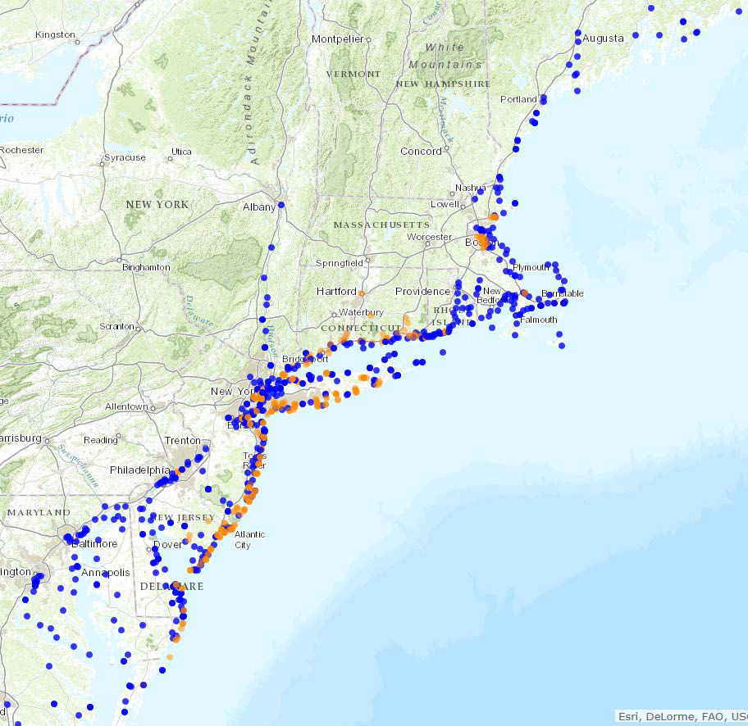

Slide 4
SWaTH
Entire proposed network consists of about 1,000 sites:
76 non-USGS stations
162 coastal stations/tidal streams
60 rapid-deployment gages
384 temporary storm-tide sensors
217 temporary wave sensors
102 temporary barometric-pressure sensors
Pre-emptive network
Northeast Coast from Virginia to Maine
Nor’easters and tropical storms of varying magnitude
Data distributed through an online mapper termed Short-term Network

Slide 5
Alternatives

Slide 6
Cellular
Working with Verizon Wireless to develop a private data network with prioritization. Tentative- Each WSC will fund own and control own usage under a “family” or shared data plan. Higher tier level support structure. Experience has been good. Better overall coverage/availability. Approval gained through IT/IOS. At Reston for final workups.
Cellular users have experienced good results across the board. Good feedback. Several projects/small networks in existence in various areas around country for WMA.

Slide 7
Iridium
Interest growing, esp. For two-way comms, command and control options, on-demand data, backup to GOES. Working with DOD/DISA on use of gateway (NOS and Sutron have assisted by providing info and/or contacts). DISA working toward restructure of costs in order to attract more Federal users. Our best option appears to be falling under existing National Park Service plan with DISA. They are in favor and are working with us to make happen.

Slide 8
Meteorburst
Meteorburst- Maiden Rock Communications (was Meteorcomm) has developed newer model meteorburst radio with IP capability, better power management options. Our use is the ELOS two-way capability of the radio for networks.
Most prolific for us is in Austin TX flood warning. 50 mile radius and expanding. Also, San Antonio is looking into this option.

Slide 9
Spectrum
Reaching out to WSC’s with information via memo from Director of Water. Information will contain a summary of what is going on and what might be coming down the line.
Will also contain information that can be passed along to cooperators to inform them of the threat as well as provide possible avenues (FCC comments, contact representatives) for them to express concerns.

Slide 10
Training
Hydrologic Instrumentation Facility offers 3 courses taught 2X per year:
Basic Electronics and troubleshooting for gaging stations - 18 seats
Data Collection Platform training – 18 seats
Water Quality Instrumentation – 16 seats
Priority based on availability: USGS, OFAs
Contact: Richard Pardee at rwpardee@usgs.gov

