Slide 1

New DCS Administration and Data Distribution System (DADDS) New Features
Letecia Reeves, GOES DCS Customer Service Specialist
NOAA/NESDIS/OSPO/SPSD
Letecia.Reeves@noaa.gov
301-817-4563

Slide 2
Online GOES DCS SUA
New process for submitting both Initial and Renewal GOES DCS SUAs
  All SUAs are submitted and processed online through the DADDS website at https://dcs4.noaa.gov

Slide 3
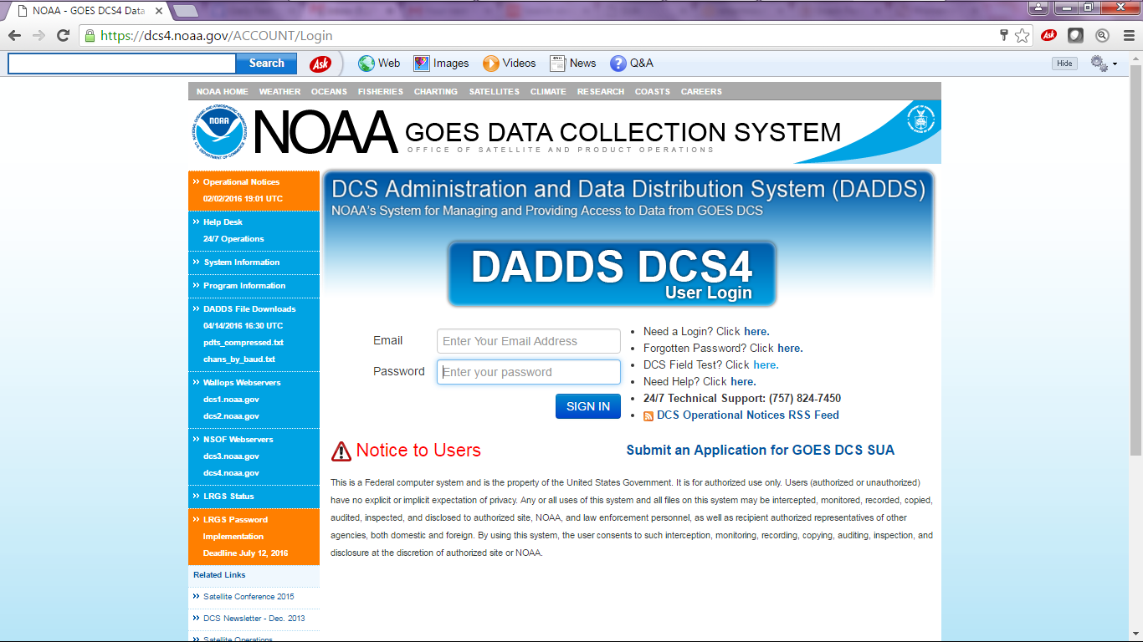
Click on “Submit an Application for GOES DCS SUA” for initial/new SUAs

Slide 4
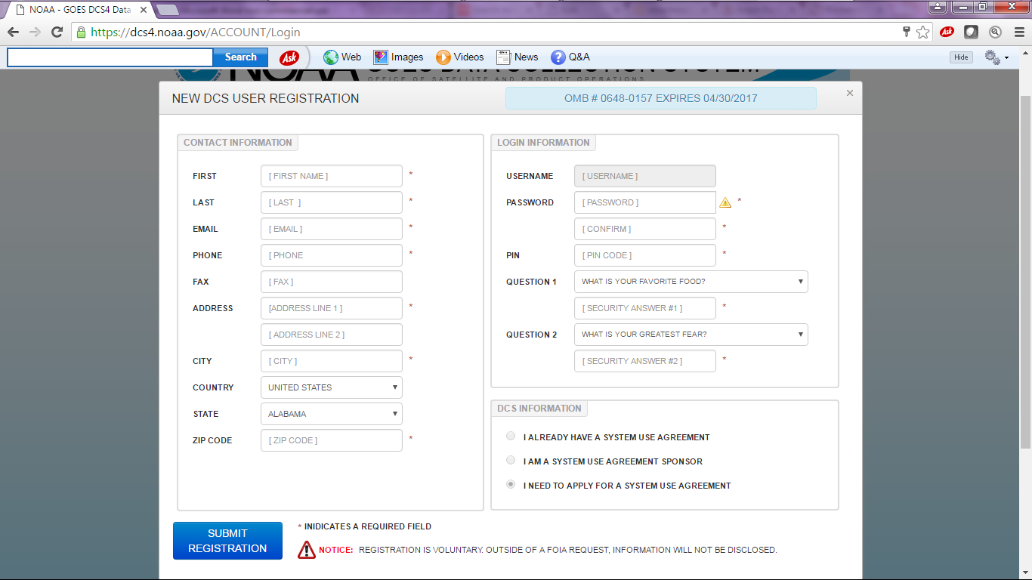
Required to complete registration before submitting the SUA

Slide 5
Initial SUA
Initial registration will require you to create a 12 character password as well as a 4 digit PIN.
The PIN is very important to remember in case you forget your password
Once you submit the initial registration you will be able to login to the DADDS to submit System Use Agreement.
  You will not have full access to the DADDS until the SUA is approved by NESDIS.

Slide 6
Updating and Renewing Existing SUAs
The person listed in the SUA as “requester” will receive renewal notifications via email.
  Typically the person who submits the SUA is automatically listed as “requester”. This role can be updated by Administrators at any time. Requester must be registered in DADDS.
  Important to keep your DADDS registration up to date

Slide 7
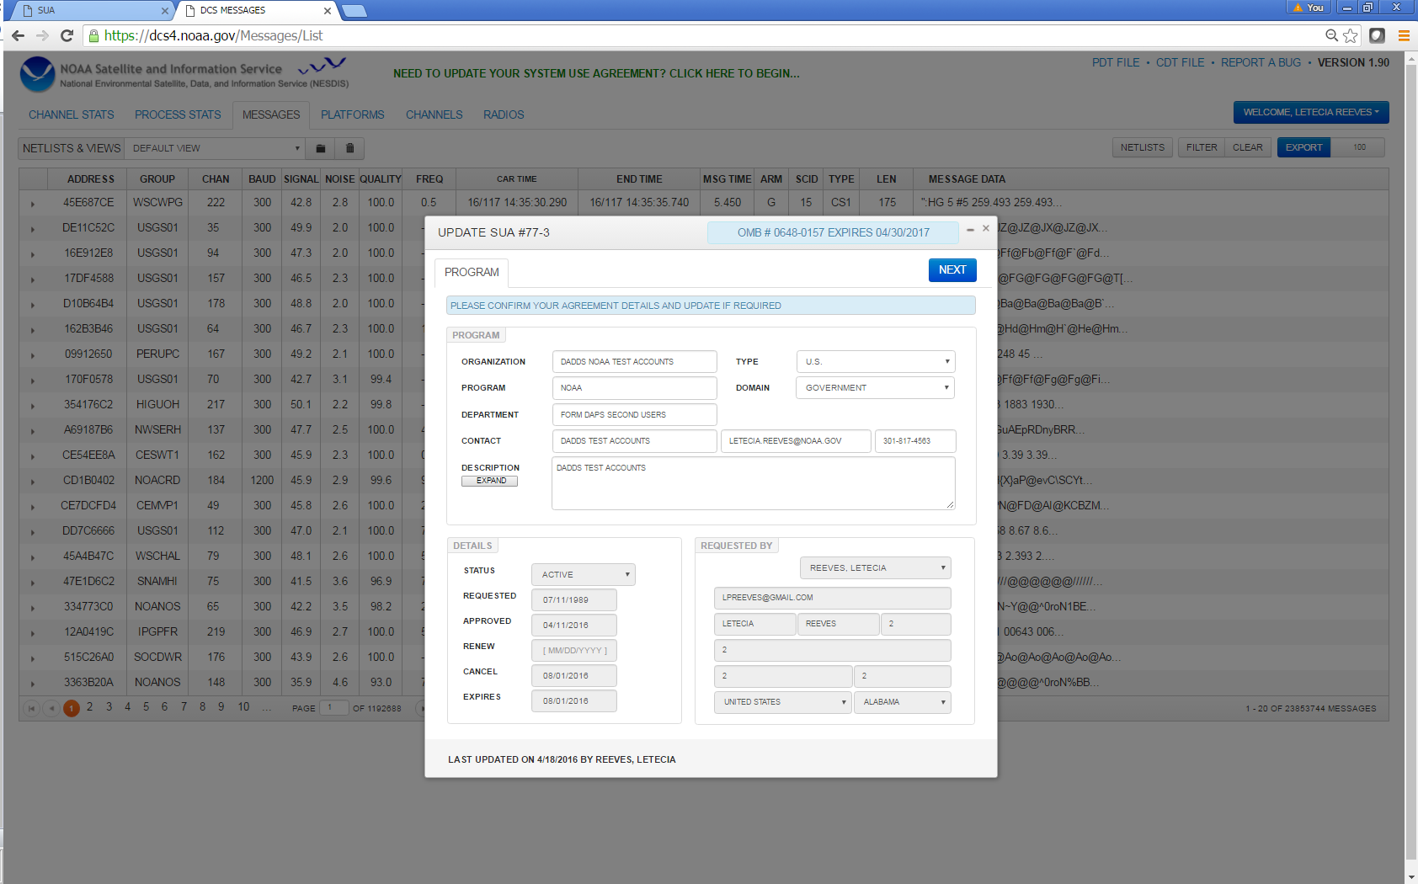

Slide 8
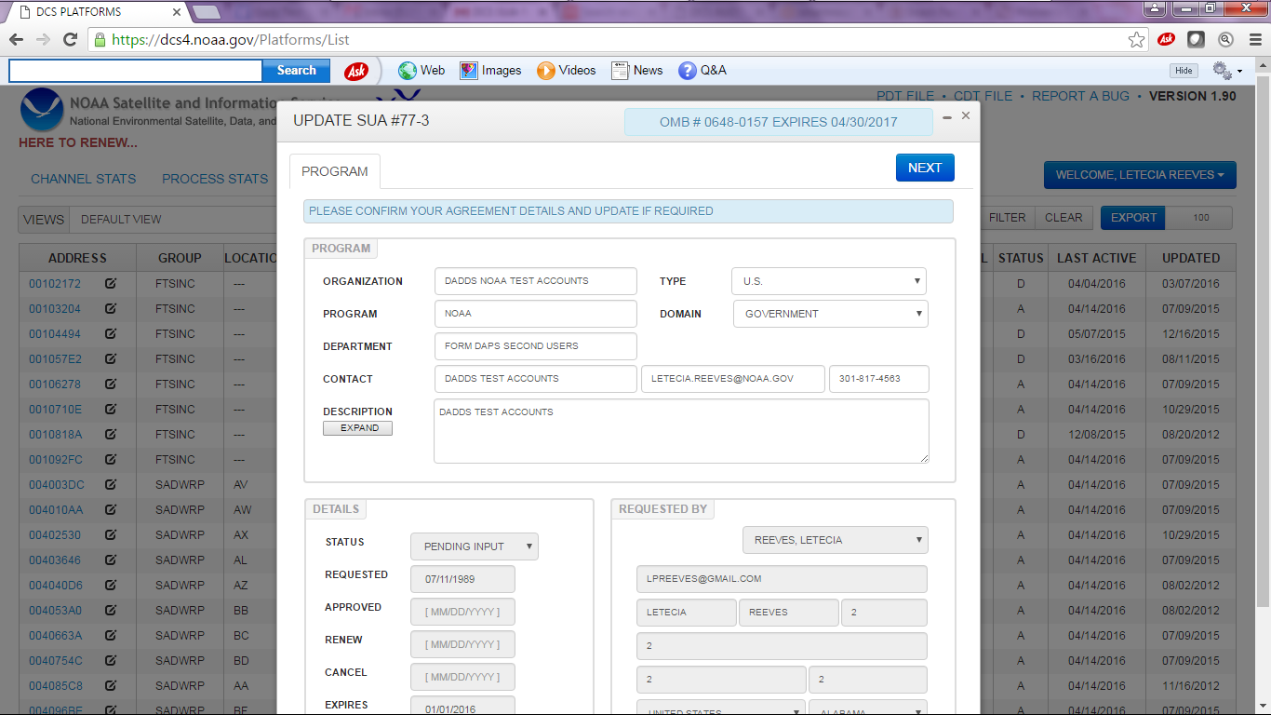
Updating and Renewing Existing SUAs cont.
The email notification will request the User to login to DADDS to update SUA. User will be prompted to update SUA once logged in.

Slide 9
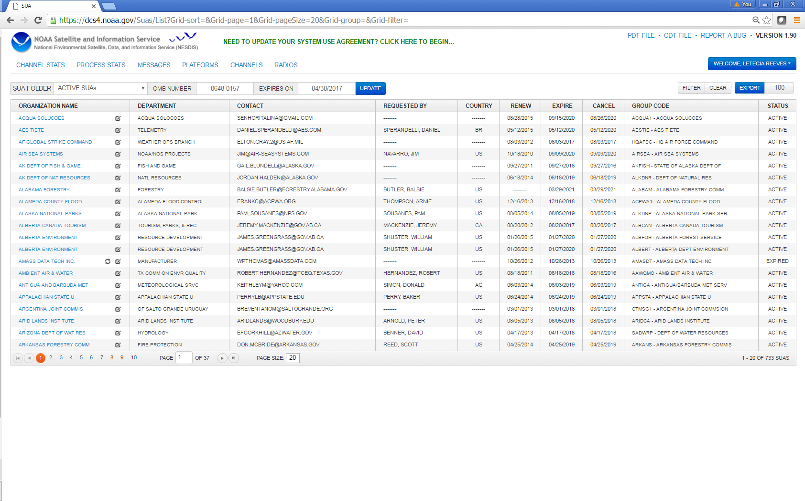
Updating and Renewing Existing SUAs cont.
There is also an option to update the SUA at anytime by clicking on the renewal link.

Slide 10
DADDS Registration for Existing SUA
Since there are no registration limitations for each Organization, we encourage all involved with GOES DCS to complete a DADDS registration and become familiarized with the system.

Slide 11
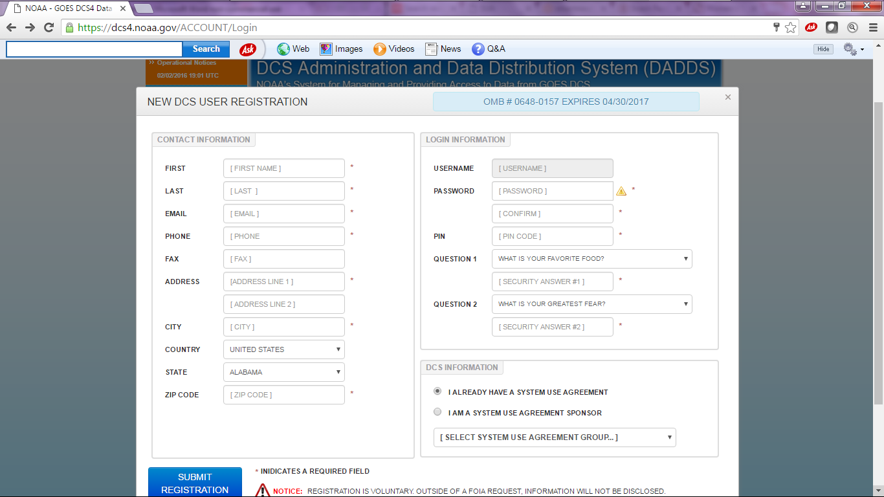
DADDS Registration for Existing SUA

Slide 12
DADDS Registration for Argos SUA
Processing of Argos (Polar DCS) on same site
CLS America (arm of French Space Agency) administers Argos applications, which still must be approved by NOAA
CLS submits Argos applications directly into DADDS via Email
Process then follows similar approval path

Slide 13
DADDS Registration for Direct Readout Users (DRO)
Online Registration for all NOAA users of Direct Readout and other Services
Eventually will be used to create mailing lists instead of DADDS
Goal will be to use DADDS only for actual DADDS users and personnel necessary for DCS Administration

Slide 14
Creating Netlists
Netlists enable you to download messages by platform list
- First create a filter with condition specifics such as group codes or individual PDT IDs under the Platform Tab.
- Click on Netlist button to create and name netlist. Select filter type and date range (now - 30days, now – 2 days)
-File name will appear in the message tab
Netlists may also be uploaded, (ie from your LRGS netlist)
Will be Expanded to Include Global Database Update by Netlist
An automated process will be available when machine to machine interface function is created.

Slide 15
Additional Features
DCS Field Test (Dan wants you to use THIS one)
Audit Track (changes to database recorded)
Group Code Added to Message Data
Group Manager Role added to User Profile
DADDS feed to LRIT

Slide 16
Upcoming Features
Machine to Machine Interface
Updates to DADDS from Transmitters
DADDS will be prepared to accept changes
Vendors/users included in plan to define process
Unused flag bit used to signal database update
DADDS prepared to manage 2 way communication
CS2 tracking tools built to manage CS2 transition
Input directly into MADIS stream for HADS (NWS)
Format Optimized for HADS use
Transition of NWSTG feed from Silver Spring to College Park
More Data Download Options

